Slide 1


Job Recommendation System Using Machine Learning
This project aims to create a job recommendation system that utilizes machine learning to improve job matching for users. The system analyzes job titles and key skills, providing personalized recommendations based on user search history.

Slide 2


Project Objective and Motivation
1
Objective
2
Motivation
The primary goal is to develop a job recommendation system that suggests relevant job opportunities to users based on their search history and job-related data.
Traditional job search methods often struggle to provide personalized recommendations. This project aims to enhance the job-seeking experience by leveraging machine learning to make it easier for users to find suitable job openings.

Slide 3
Dataset Overview
Feature
Description
Job Title
The title of the job position.
Key Skills
Skills required for the job.
Job Salary
The offered salary for the job.
Job Experience Required
Experience level required for applicants.
Role Category
Classification of the job role.
Functional Area
The functional area the job belongs to.
Industry
The industry in which the job is categorized.

Slide 4
Data Exploration and Insights
Summary Statistics
Visualizations
The dataset comprises 27,010 job postings, featuring both categorical and numerical data. No missing values were found in any of the columns.
The distribution of job titles across the dataset and the frequency of key skills associated with job postings were visualized through charts and graphs.
We use summary statistics to get an overview of the numerical features.
Key Numerical Insights:
Dive into the Data

Slide 5
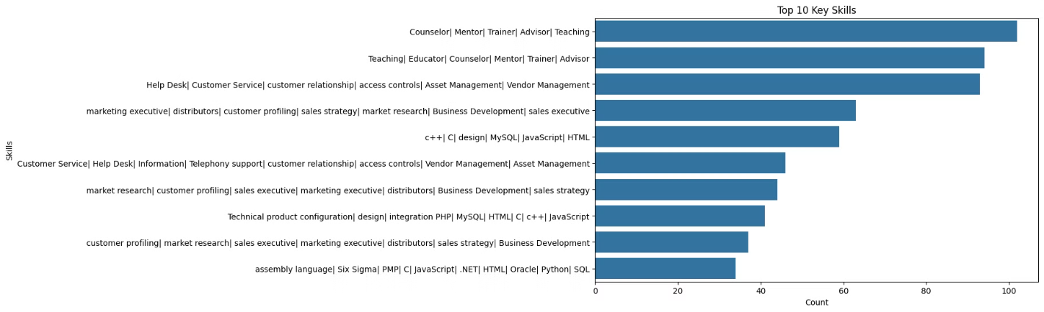
In-Demand Skills Revealed
This eye-catching bar graph spotlights the top 10 most sought-after skills in job postings. Quickly identify the must-have capabilities that will give you a competitive edge and guide your personal development.

Slide 6
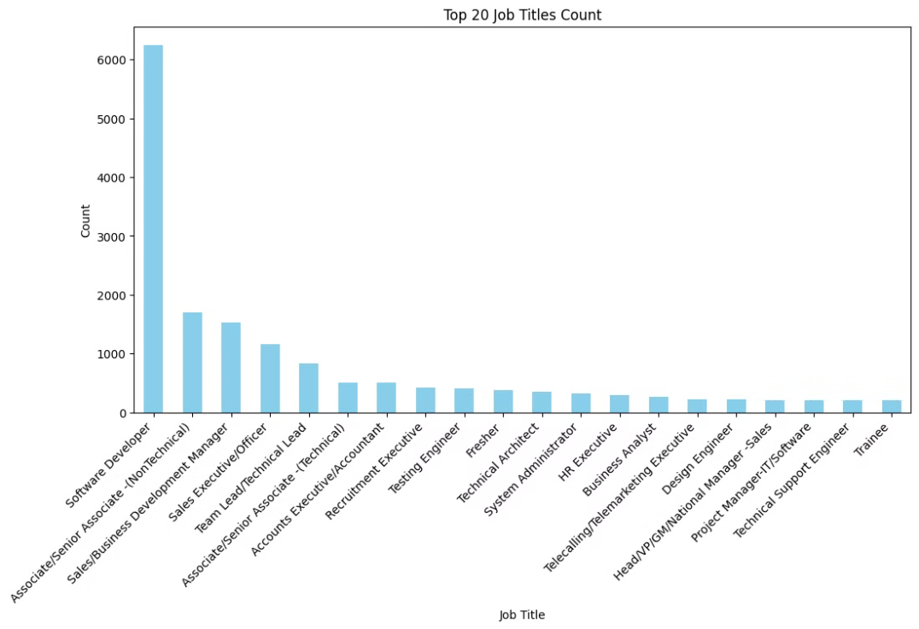
Unlock the Most In-Demand Roles
This eye-catching bar chart spotlights the 20 most frequently listed job titles. Quickly identify the high-growth positions that are in the greatest need of talented candidates like yourself. Use these insights to guide your career exploration and development.

Slide 7
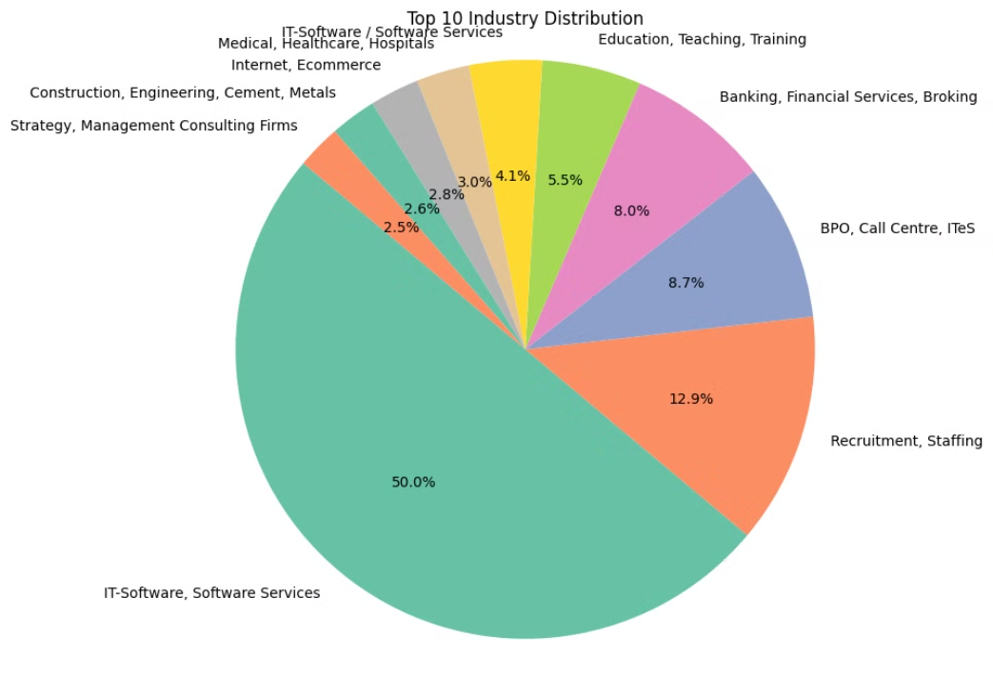
Discover the Industry Landscape
This vibrant pie chart paints a vivid picture of the top 10 industries by job posting count. Quickly identify the sectors that are experiencing the highest demand for talent and uncover the industries that offer the greatest career opportunities. Use these insights to strategically align your skills and experience with the most promising job markets.

Slide 8
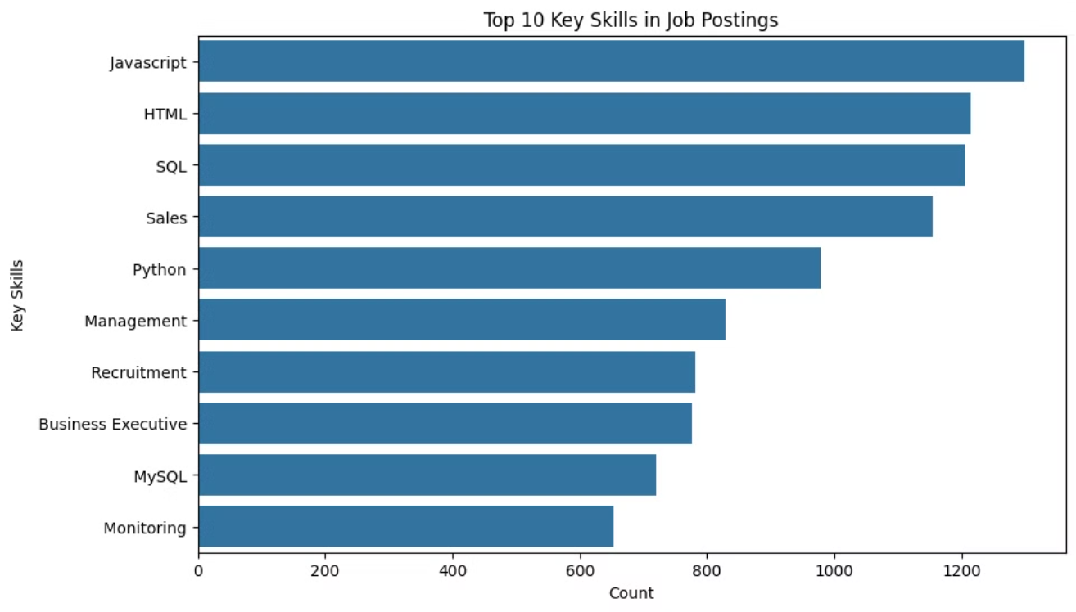
Master the Skills Employers Demand
This dynamic bar chart shines a spotlight on the 10 most sought-after skills across the job market. Quickly identify the core competencies that hiring managers value most, and use this intelligence to hone your professional profile and stand out from the competition. Mastering these high-impact skills can unlock a wealth of career opportunities.

Slide 9
Data Preprocessing and Feature Engineering
1
Combining Features
To enhance the model's performance, Job Title and Key Skills were combined into a new feature called combined\_features. This new feature captures the relationship between job titles and required skills.
2
TF-IDF Vectorization
TF-IDF (Term Frequency-Inverse Document Frequency) vectorization was used to transform textual data into a format suitable for machine learning models. The TfidfVectorizer from Scikit-learn was employed to fit the vectorizer to the combined\_features and transform the text data into a sparse matrix of TF-IDF features.

Slide 10
Machine Learning Models and Selection
Logistic Regression
K-Nearest Neighbors (KNN)
Random Forest
A linear model used for binary and multiclass classification.
A non-parametric method for classification.
An ensemble learning method that operates by constructing multiple decision trees.
Support Vector Machine (SVM)
Naive Bayes
A supervised learning model that finds the hyperplane maximizing the margin between classes.
A probabilistic classifier based on Bayes' theorem, assuming independence among features.

Slide 11
Model Evaluation and Results
Model
Accuracy
Precision
Recall
F1 Score
Logistic Regression
0.825
0.777
0.825
0.786
K-Nearest Neighbors
0.724
0.712
0.724
0.703
Random Forest
0.887
0.868
0.887
0.870
Support Vector Machine
0.883
0.857
0.883
0.866
Naive Bayes
0.441
0.355
0.441
0.307

Slide 12
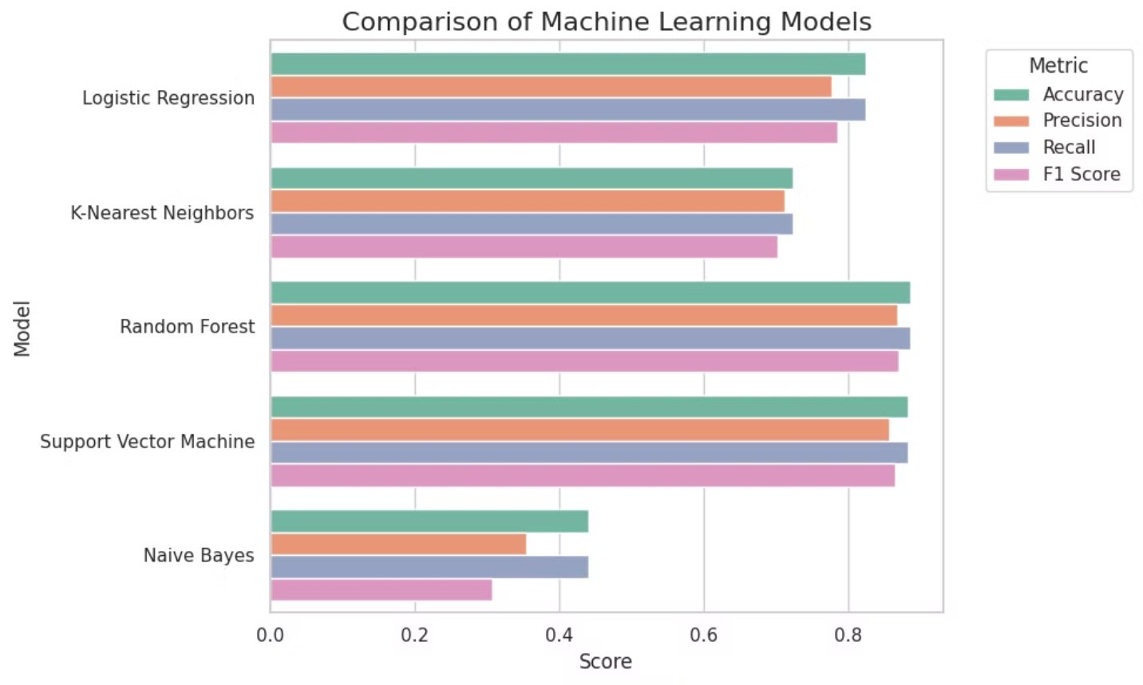
Comparison of machine learning models

Slide 13





Recommendation Engine Functionality
Search History
The recommendation engine leverages the user's search history to suggest jobs that align with their interests.
Random Forest Model
The trained Random Forest model is used to predict job titles based on combined features.
Job Recommendations
The system provides personalized job recommendations based on the user's search history and the model's predictions.

Slide 14




Conclusion and Future Work
Achievements
The project successfully developed a job recommendation system that uses machine learning to enhance job matching for users.
Future Work
Potential improvements include incorporating additional features, implementing more advanced models, and collecting user feedback to refine the recommendation algorithm.

Slide 15
Thank you
Questions?
Thank you for your attention! I appreciate your interest in my project. I look forward to your questions and feedback.

